Slide 1
WOMEN’S SAFETY DEVICE
Real time location tracking & emergency message transmission
Shane Parmar 61
Mohit Rao 76
Cleetus Rodriguez 77
Anto Fernando 99

Slide 2
TABLE OF CONTENT
Introduction
Methodology
Implementation
Hardware and Software requirements
Testing
Conclusion

Slide 3
INTRODUCTION
Safety is a major issue for women in today’s India.
Statistics indicate major crimes against women in cities go unreported or unsolved due to lack of immediate reporting and delayed police action.
Subsequent lack of arrests in regards to these crimes only embolden the culprits further and create an environment of lawlessness.
Such crimes include assault, molestation, kidnappings, stalking.
Technology can be effectively deployed to ensure immediate police intervention when such misdeeds take place.

Slide 4
PROJECT STATEMENT
This project makes combined application of principles of Internet of Things and cloud computing, to enable generation and transmission of emergency message to authorities, capturing pictures of the scenario as well as real time location tracking of user.
As the women feels insecure at that time she can press the fingerprint sensor, which will activate the device.
The integrated modules will work in cohesion to notify her selected contacts and the police of her current location, thus enabling intervention in an active crime.
These small things can ensure that the women is safer than she was before.
The device thus ensures a woman’s safety by applying technological solutions.

Slide 5
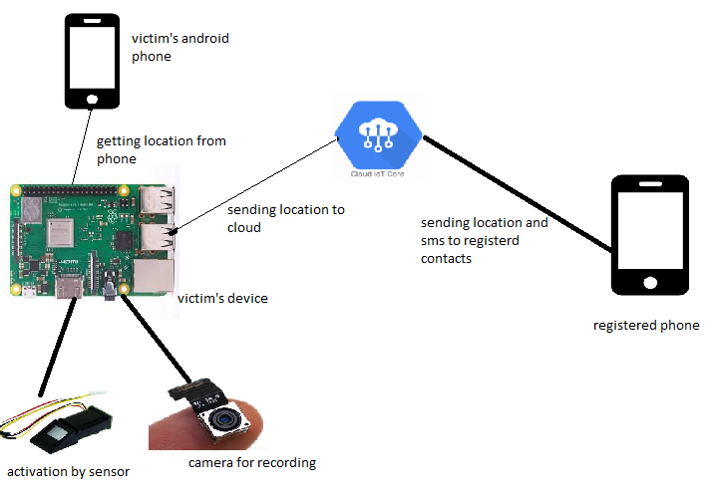
ARCHITECTURE DIAGRAM

Slide 6
REVIEW OF LITERATURE
All in one Intelligent Safety System for Women Security : The paper proposes system can be implemented as an android app application or using Arduino based board.
An Intelligent Safety System for Individual’s Security : The paper propose an android application which is activated with the vibrate sensor and opens the application.
Intelligent Women’s Safety System : The paper proposes wireless key GSM and GPS module with controller. As the women feels insecure at that time she can press the wireless key then the GPS and GSM modules are activated.
Emergency Alert for women’s safety with location tracking : This project proposes ATmega328 with GPS and GSM modems.The detection and messaging system is composed of a GPS receiver, Microcontroller and a GSM Modem.

Slide 7
METHODOLOGY
In this project we are providing facility to secure the women’s by providing fingerprint sense GSM and GPS module and a mini Camera to take pictures at the time when the women feels insecure.
As the women feels insecure at that time she can press the fingerprint sensor, this will activate the device.
The woman’s android phone provides GPS and GSM modules for use to the device, which are used to obtain her coordinates and thus determine her position.

Slide 8
Once the system is activated, the woman must keep scanning her finger within a predetermined amount of time.
Failure to do so triggers the failsafe mechanism, sending current real time location as well as a generated emergency message to her selected contacts and the authorities.
The camera can capture images of her surrounding or of the culprits harassing her and these images are sent to the police as evidence.

Slide 9
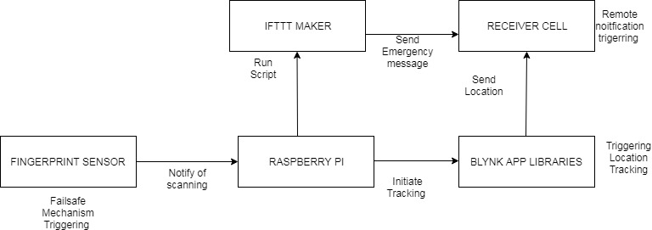
BLOCK DIAGRAM

Slide 10
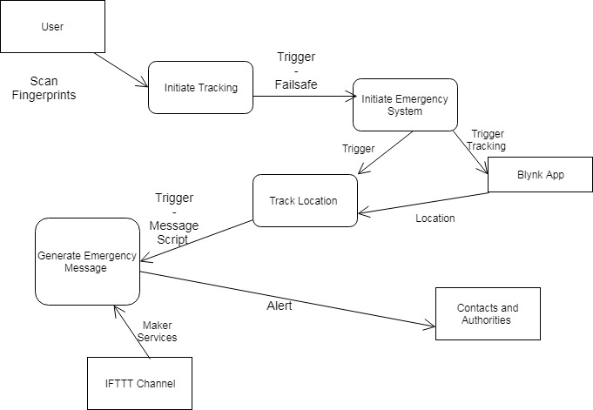
DATA FLOW DIAGRAM

Slide 11
IMPLEMENTATION
Device Design -
Raspberry Pi 3 B + acts as the microcontroller.
It will be powered with a portable battery to ensure portability .
Fingerprint scanner serves the dual purpose of being a trigger button as well as ensuring unique user identification.
After activation of device, user scans her finger once to initiate the tracking mechanism, after which she must scan it again after allotted time
Failure to do so triggers a failsafe mechanism that sends real time current location of user and emergency message to her contacts and the authorities.

Slide 12
Software implementation for location tracking -
GPS of user’s android phone is used to obtain the coordinates with the help of blynk.
Once the devices is activated, Python script enabling tracking runs in the background.
Real time location of the microcontroller is updated in the cloud server.
Open source Blynk server forwards information between Blynk mobile application and the microcontroller.

Slide 13
Sending emergency message -
Failsafe mechanism triggers the generation and transmission of emergency message to selected contacts and the authorities
IFTTT used to daisy chain applets that execute successively and sends an sms as soon as the print is not scanned after allotted time.
IFTTT allows creation of applets that respond to certain triggering events with predertmined action.

Slide 14
Live streaming from the user’s current location
Real-time streaming from the user can be very beneficial in such a scenario. A 5 Mp Raspberry Pi 3 B Picam has been attached to the device enabling live video capture. The python script enabling real-time video streaming will be triggered once the user fails to scan her finger after allotted time period.
For the purpose of the project, one can access the video streaming through any device that has a browser and is connected to the same network as the Pi. During fully functional scaling, a public server will be set up thus enabling streaming to authorized contacts as well as authorities.

Slide 15
HARDWARE REQUIREMENTS
Raspberry Pi 3 B +
Raspberry Pi Camera Module
Fingerprint Sensor
Android Phone
Raspberry Picam (5 mp)

Slide 16
SOFTWARE REQUIREMENTS
Blynk App and associated libraries
IFTTT maker channel linked to a Gmail account
Raspbian Operating system
Scripting Language - Python 3.0

Slide 17
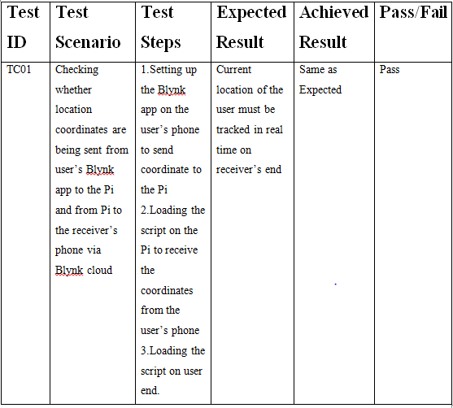
TESTING

Slide 18
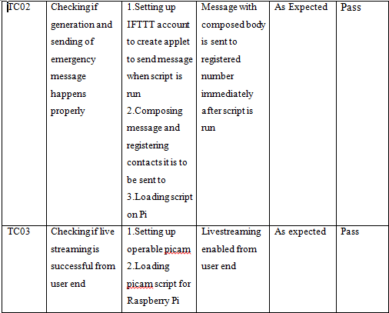

Slide 19
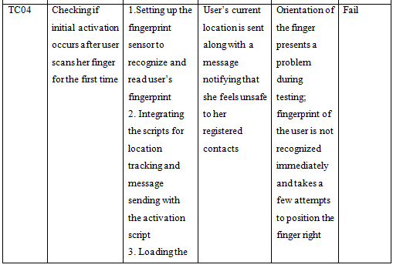
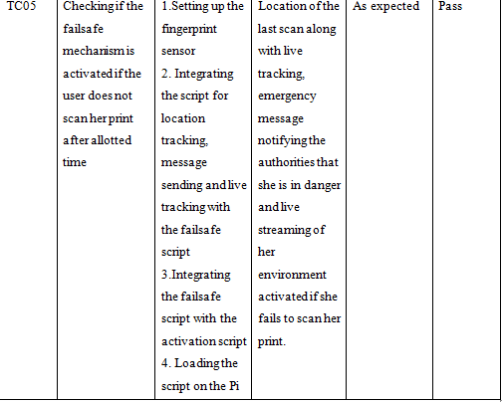

Slide 20
CONCLUSION
An effective way to tackle the social issue of women’s safety using technological innovation can be devised, as shown through this project. This project thus addresses a major fault in our law and order apparatus, by making efficient use of IoT. Further applications of IoT can address societal issues and bring about improvements in our daily lives.
Future Scope
Open server for live streaming as well as independent location tracking cloud facilitating
Robust SMS gateway

